Slide 1

U19CS801 –PROJECT WORK
Zeroth Review
DISEASE PREDICTION AND TEXTURE ANALYSIS IN NAILS USING MACHINE LEARNING

Slide 2
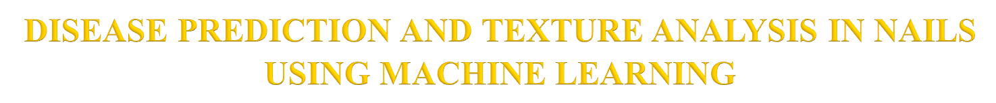
Team Members:
1. Rithika.R (1919102122)
2. Pooja.S (1919102106)
3. Rohinth.S (1919102125)
Name of the Supervisor: Dr. S.Vidhushavarshini

Slide 3

In an early stage of diagnosis, this experiment suggests utilizing nail color to forecast disorders. Our project's primary goal is to study the illness without endangering people.
In the older, more conventional method of disease detection, doctors would look at the patients' nails and make a diagnosis. Patients' nails can be examined to help diagnose a variety of illnesses.
Our suggested solution is entirely computer-based, it can be quite helpful in resolving this problem. The suggested system's input is a picture of a nail.
The technology will analyze the image of the nail and extract its attributes to determine the disease. Our suggested technique leverages variations in nail color to identify sickness.

Slide 4

The modern approach to healthcare is to prevent the disease with early intervention rather than go for treatment after diagnosis.
The main objective of our project is to predict many diseases by observing the color of human nails.
The types of Diseases can be identified based on the color and texture of the nails and will be classified and processed by a convolutional neural network.
The disease can be identified and diagnosed in the early stage.

Slide 5

S.No | Author, Paper Title & Journal Name, Year | Methods/Technique/Algorithm | Dataset | Limitations
1 | Dhanashree, K. "Fingernail analysis for early detection and diagnosis of diseases using machine learning techniques." International Journal of Nonlinear Analysis and Applications 13 (2022): 61-69. | Block Chain Technology (BCT), Machine Learning (ML) | Weka Tool, kaggle. | Security and privacy is still challenging when working with patient’s data
2 | Indi, Trupti S."Early stage disease diagnosis system using human nail image processing." IJ Information Technology and Computer Science 7 (2016): 30-35. | An Integrated Deep Learning Framework, framework uses a hybrid of Convolutional Neural Network (CNNs) | kaggle | Resolution and small amount of color change in few pixels on nail

Slide 6

S.No | Author, Paper Title & Journal Name, Year | Methods/Technique/Algorithm | Dataset | Limitations
3 | Regin, R. "Nail Disease Detection and Classification Using Deep Learning." Central Asian Journal of Medical and Natural Science 3, no. 3 (2022): 574-594. | Deep Learning CNN | kaggle, Weka Tool(unaffected nails and affected nails) | Small Changes in the nail cannot be recognized by the software.
4 | Juna, V. V."A review on nail image processing for disease detection." Recent Trends in Analog Design and Digital Devices 2, no. 3 (2019). | ESDD system Trained by Weka tool MATLAB software | Manual Data set | Weka Tool cannot identify the image with high resolution.

Slide 7
S.No | Author, Paper Title & Journal Name, Year | Methods/Technique/Algorithm | Dataset | Limitations
5 | Marulkar. "The New Horizon in Disease Detection in Humans." In THEETAS 2022: Proceedings of The International Conference on Emerging Trends in Artificial Intelligence and Smart Systems, THEETAS 2022, 16-17 April 2022, Jabalpur, India, p. 101. European Alliance for Innovation, 2022. | Convolutional Neural Network (CNN) | NIST Special 301 Data sets. | The accuracy of CNN is wrongly calculated.
6 | Indi, Trupti S. "Early stage disease diagnosis system using human nail image processing." IJ Information Technology and Computer Science 7 (2016): 30-35. | In ESDDS system, to train data (nail images of patients) proposed system using Weka tool | Kobo Toolbox, GoSpotCheck. | Not all diseases can be predicted by this system as the data set is in fewer numbers.

Slide 8

S.No | Author, Paper Title & Journal Name, Year | Methods/Technique/Algorithm | Dataset, Advantages | Limitations
7 | AbdulhadiCNN. "Human nail diseases classification based on transfer learning." ICIC Express Letters 15, no. 12 (2021): 1271-1282. | CNN MATLAB programming software | kaggle, Magpi, Fulcrum | Due to the unavailability of an existing dataset with perfect images of human nail diseases for training, the work gained more complexity.
8 | Sharma. "Nail color and texture analysis for disease detection." International Journal of Bio-Science and Bio-Technology 7, no. 5 (2015): 351-358. | MATLAB Programming | Weka Tool, Jotform. | The image is not segmented in an efficient way and it is not recognizing the complete image of the nail.

Slide 9

Existing system drawbacks
As very few data set is trained, only specific diseases can be predicted.
Small Changes in the nail cannot be recognized.
The raw image is not patterned, it is directly compared with the data set and it will not calculate the accurate value.

Slide 10
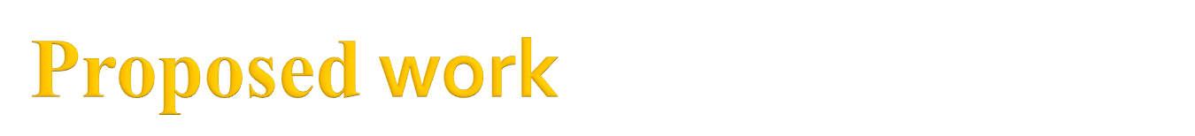
A bunch of strategies or standards or rules for directing the cycle is called System.
The Proposed Model has four significant stages:
1)Input to the model: Filtering the picture containing fingers, rear of palm locale in fitting splendor.
2)Extraction of the cropped Nail region from the entire Palm: Applying division strategy on the picture to separate the nail from the whole picture.
3)Analysis of the Nail region, Color, and Texture: The fragmented nail picture is presently being handled based on variety and surface and we will decide the well-being of the nail by contrasting the fragmented picture and the dataset present.
4)Disease Prediction using Knowledge base: The outcome will be produced on the premise of investigation and the illness would be anticipated if present.

Slide 11
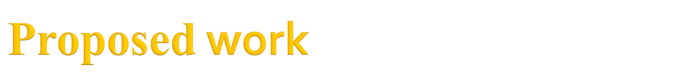
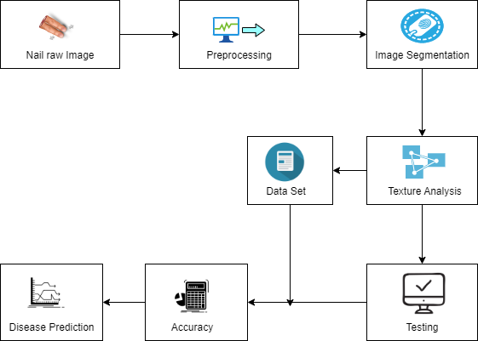

Slide 12
Nail raw image
The fingernail is typically the input image taken into account. A digital camera with a high resolution will be used to record the photographs.
In some cases, the input image can also be obtained and used by scanning it.
Preprocessing
The aim of pre-processing is an improvement of the image data that suppresses unwanted distortions or enhances some image features important for further processing.
Image Pre-processing is a common name for operations with images at the lowest level of abstraction. Its input and output are intensity images.

Slide 13

1)Image Segmentation
Image segmentation must be done after the input image has been obtained. Using the built-in crop feature, the palm may be divided into sections.
The process of segmenting or separating a picture into separate portions to find the region of interest is known as image segmentation. In the suggested study, we employ a region-based segmentation method to divide up the photos. The image is divided into a variety of regions or classifications.
2)Texture Analysis
Surface examination alludes to the portrayal/characterization of districts in a picture by their surface substance.
Surface examination endeavors to measure natural characteristics depicted by terms like unpleasant, smooth, luxurious, or rough as an element of spatial variability in pixel forces.

Slide 14

The proposed system will extract texture features of human nail images for disease prediction. The system is focusing on image recognition on the basis of human nail texture analysis.
Many diseases could be identified by analyzing the nails of human nails. In this system, a human nail image is captured using the camera.
The captured image is uploaded to our system and the region of interest from the nail area is selected from the uploaded image.
The selected area is then processed further for extracting features of the nail such as the color,shape of the nail. This color feature of the nail is matched using a simple matcher algorithm for disease prediction.
In this way, the system is useful in the prediction of diseases in their initial stages.

Slide 15

[1] N. Bajpai, R. Alawadhi, A. Thakare, S. Avhad and S. Gandhat, Automated prediction system for various health conditions by analyzing human palms and nails using image matching technique, Int. J. Sci. Engin. Res. 6 (2015).
[2] N. Bajpai, R. Alawadhi, A. Thakare, S. Avhad and S. Gandhat, Automated prediction system for various health conditions by analyzing human palms and nails using image matching technique, Int. J. Sci. Engin. Res. 6 (2015).
[3] ] P. Hardik and D. Shah, The model of nail color analysis: An application of digital image processing, Int. J. Adv. Res. Comput. Sci. Software Engin.
[4] S. Hsiung Lee and C. Sing Yang, Fingernail analysis management system using microscopy sensor and blockchain technology, Int. J. Distrib. Sensor Networks 14 (2018).
[5] T.S. Indi and Y.A. Gunge, Early stage disease diagnosis system using human nail image processing, Int. J. Inf. Technol. Comput. Sci. 7 (2016).

Slide 16

[6] H. A. Atabay, “Deep residual learning for tomato plant leaf disease identification”, Journal of Theoretical & Applied Information Technology, 2017.
[7] S. Zhang, W. Huang, and C. Zhang, “Tree-channel convolutional neural networks for vegetable leaf disease recognition”, Cognitive Systems Research, 2018.
[8] ] D. P. Hughes and M. Salathe, “An open access repository of images on ´ plant health to enable the development of mobile disease diagnostics”, arXiv.2015.
[9] Y. LeCun, Y. Bengio, and G. Hinton, “Deep Learning”, Nature, 2015.
[10] V. Tumen, ¨ O. F. S ¨ oylemez and B. Ergen, “Facial emotion recognition on ¨ a dataset using convolutional neural network”, 2017 International Artificial Intelligence and Data Processing Symposium (IDAP), November 2017.

Slide 17
Thank You

